Slide 1

BDT Project
Demelash Minyahil : 613452

Slide 2
Contents
Setup servers
architecture
demo

Slide 3
Server’s setup :Kafka
- Download and install Kafka
- CD to bin folder
Run this command ./kafka-server-start.sh ../config/server.properties
Create Topic
- CD to Kafka bin folder
- Run this command
./kafka-topics.sh --create --bootstrap-server localhost:9092 --partitions 1 --replication-factor 1 --topic tweets
These two configurations are bundled in separate sh file for click and run ;simplicity. See next slide for the location

Slide 4
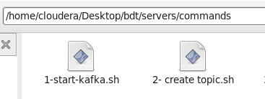
… Server’s setup :Kafka

Slide 5
Hbase/HIVE configuration
- Install and Configure Hbase/HIVE (installed in cloudera)
- start hbase-master and hbase-regionserver
- create/re-create the table named tweet using hbase shell
- run script (hive.sql) to create the table in HIVE; hive comand
These two configurations are bundled in separate sh file for click and run ;simplicity. See next slide for the location

Slide 6
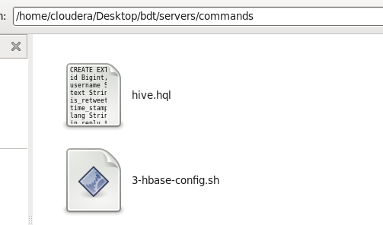
… HBASE/HIVE configuration

Slide 7
Architectural Design

Slide 8
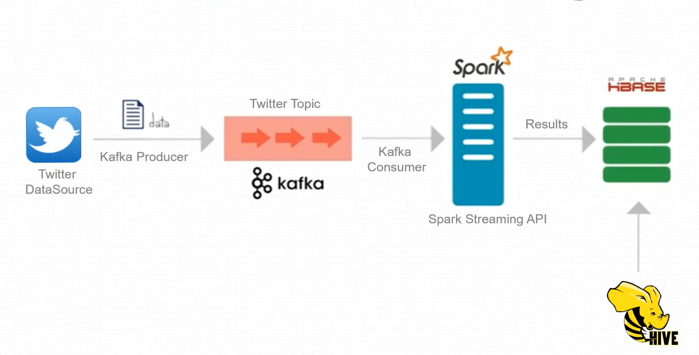
Data Flow Diagram

Slide 9
Twitter :
The Hosebird Client streaming library
Hosebird Client, a Java-based client for Twitter’s Streaming APIs
( source : https://blog.twitter.com/developer/en_us/a/2013/the-hosebird-client-streaming-library)
- OAuth integration

Slide 10
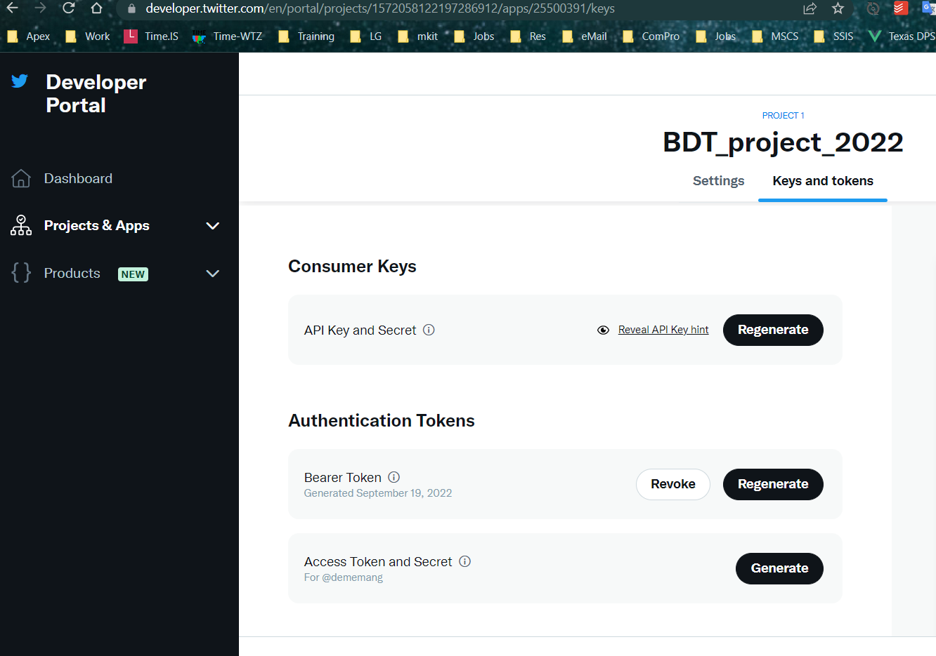

Slide 11
Twitter :
The Hosebird Client streaming library
Hosebird Client, a Java-based client for Twitter’s Streaming APIs
( source : https://blog.twitter.com/developer/en_us/a/2013/the-hosebird-client-streaming-library)
- OAuth integration

Slide 12
Producer
Twitter search Items used: GERD ,Ethiopia
Frequency : 5 seconds
Send

Slide 13
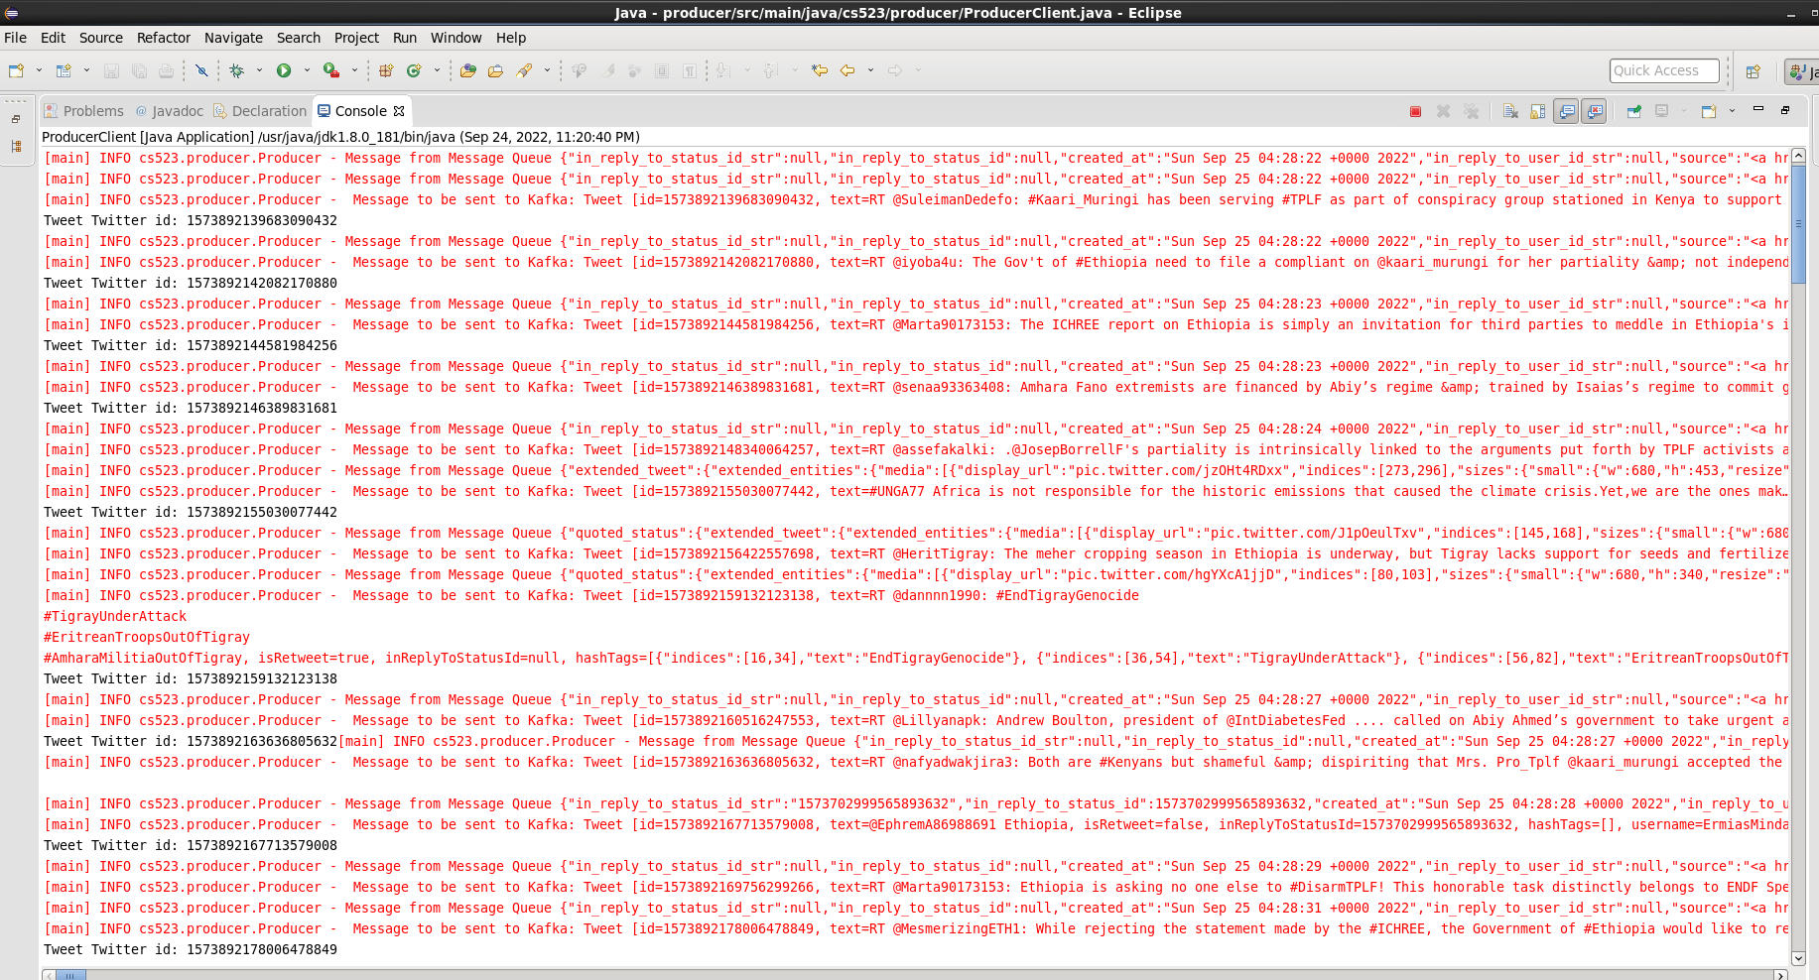
Producer

Slide 14
Consumer
Data stream is divided into batches called DStreams, which internally is a sequence of RDDs. The RDDs are then processed using Spark APIs, and the results are returned in batches.
Again, it processed into Tweet of RDD and sent to HbaseRepository to be stored in DB.

Slide 15
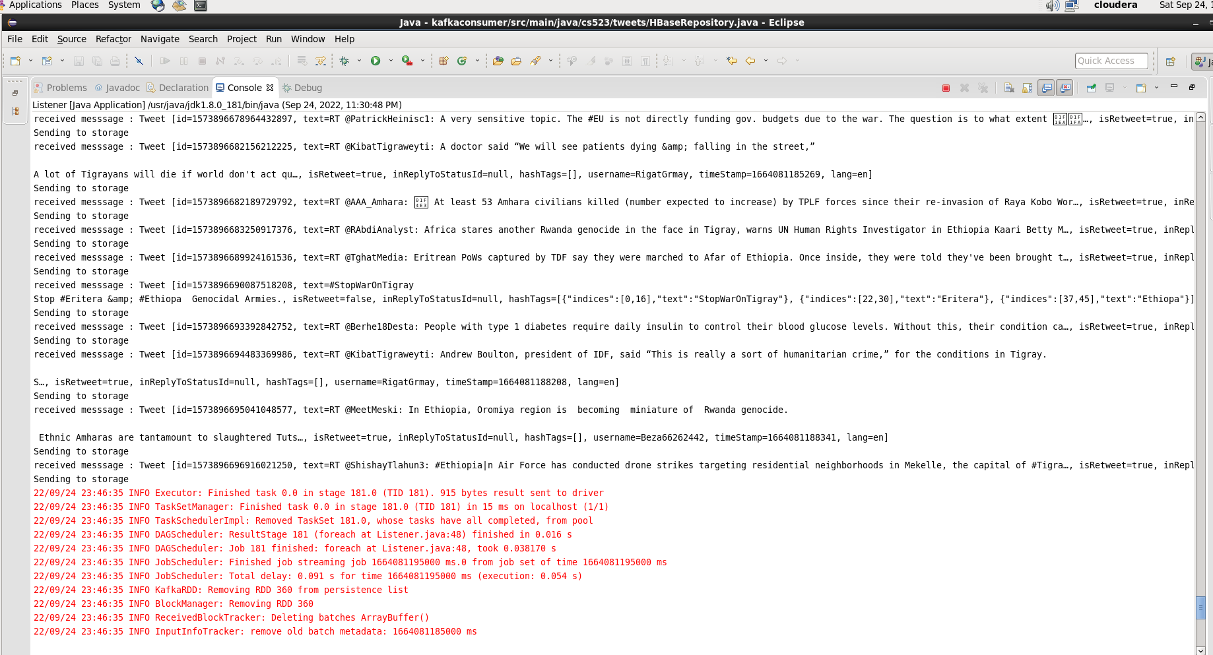

Slide 16
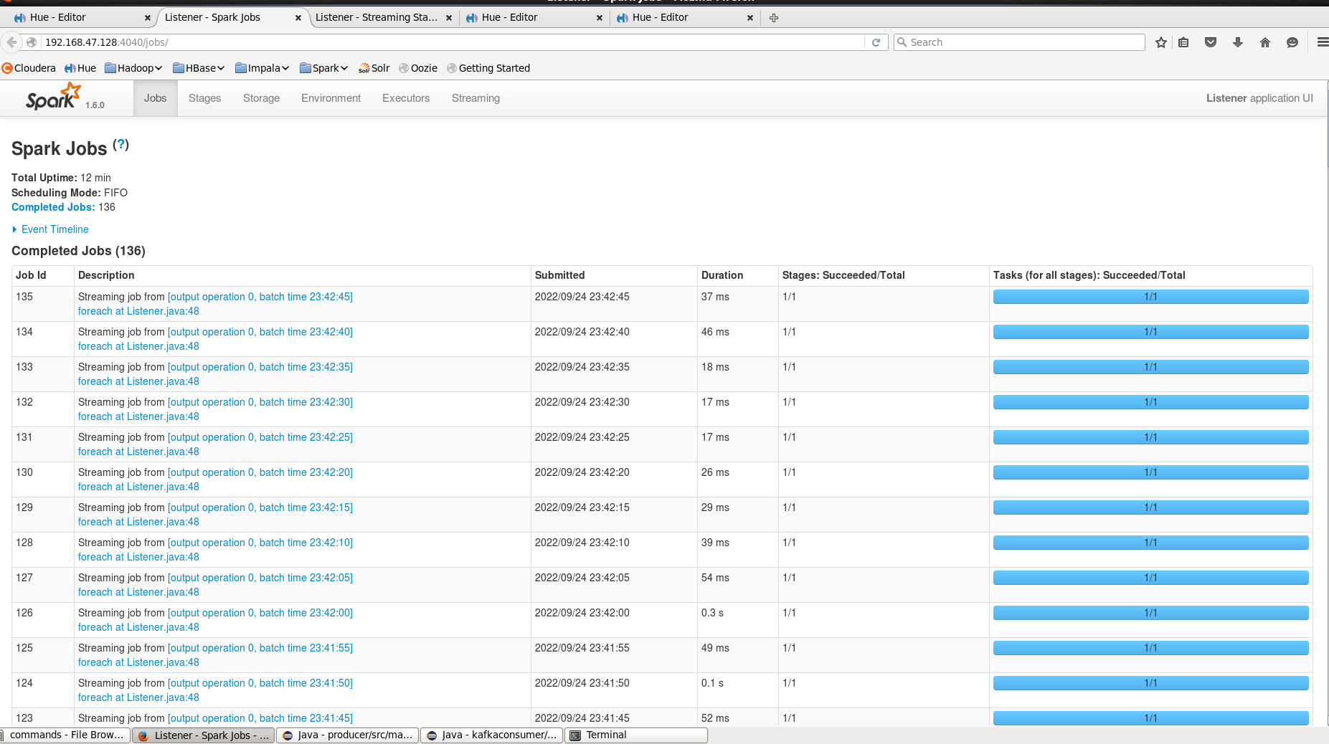
spark

Slide 17
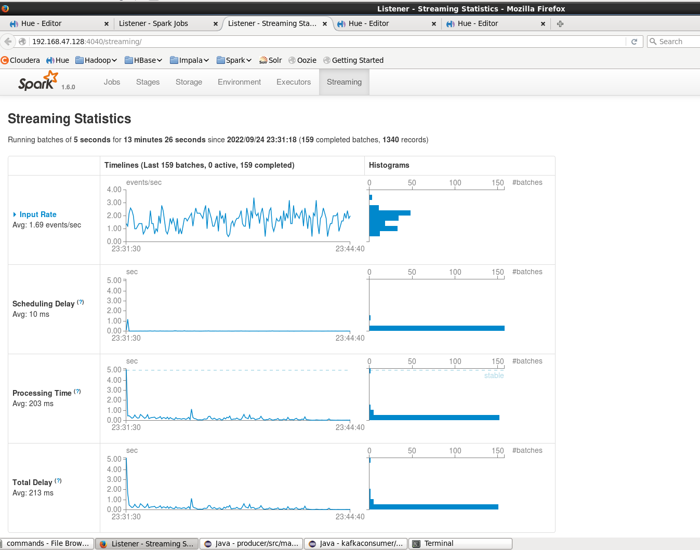
spark

Slide 18
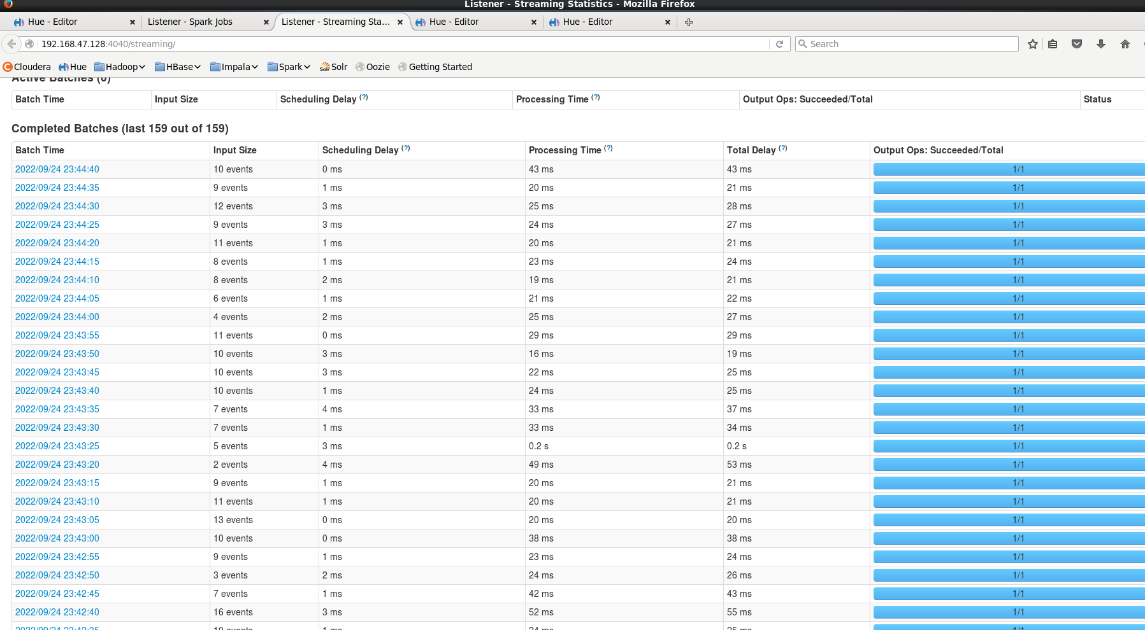
spark

Slide 19
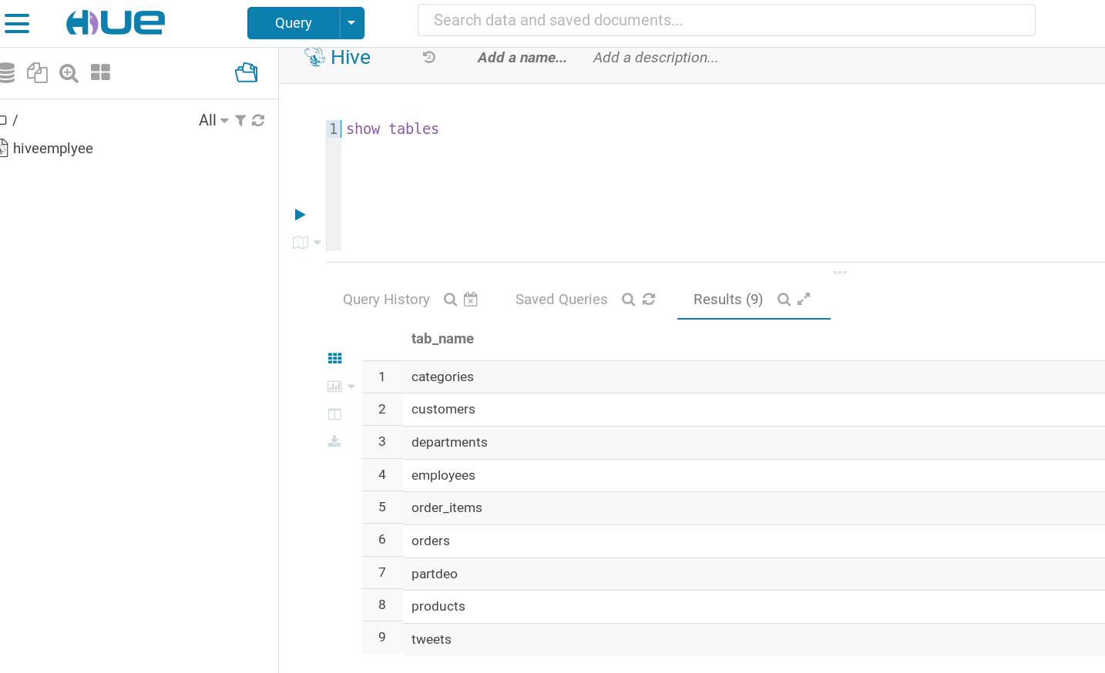
HIVE

Slide 20
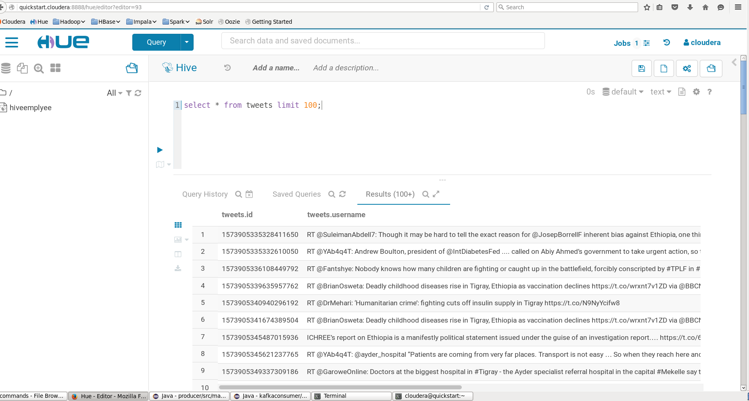

Slide 21
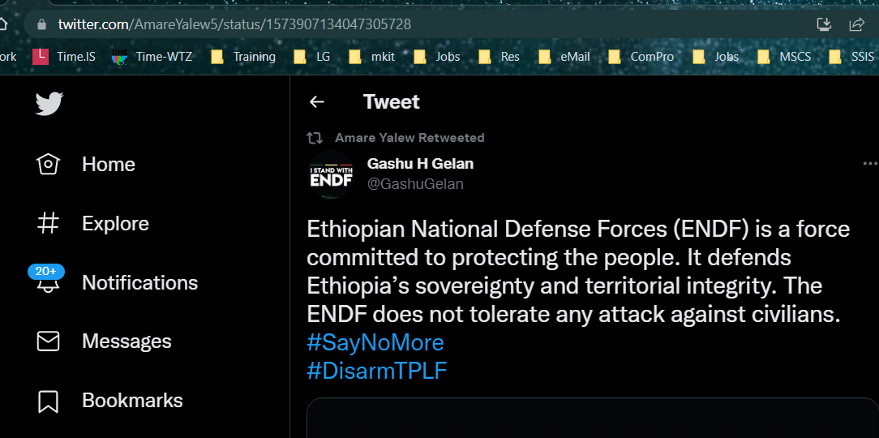
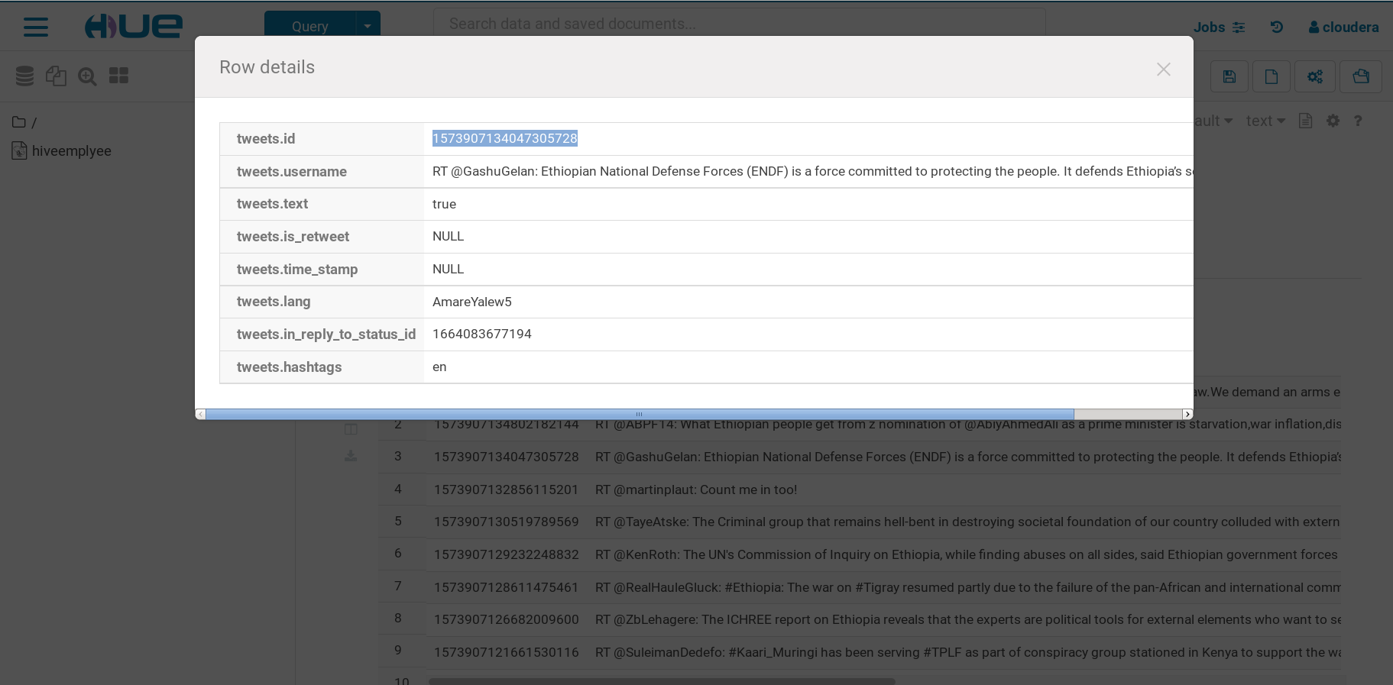
Tweet Id: 1573907134047305728

Slide 22
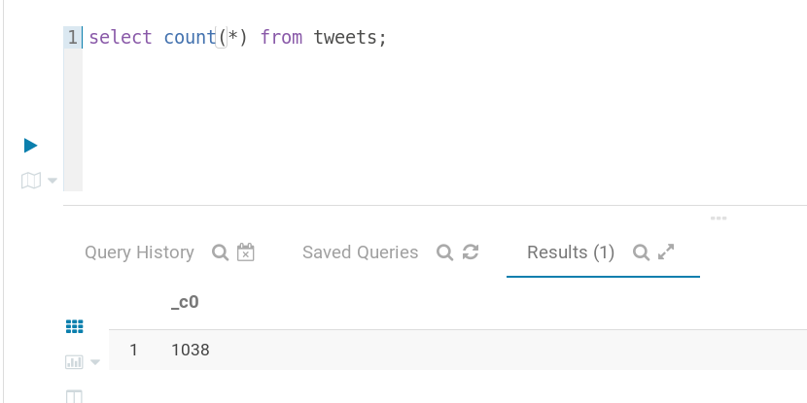
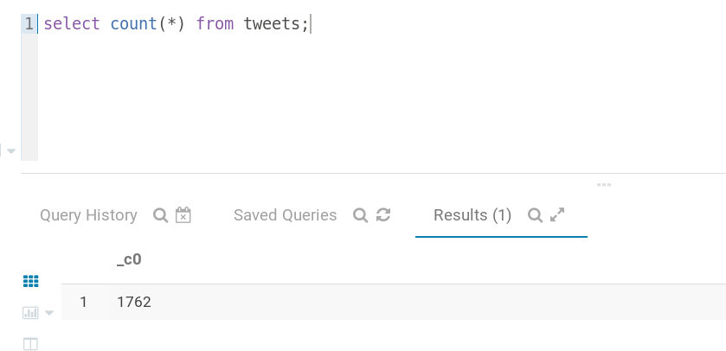
Tweets count :sample with time

Slide 23
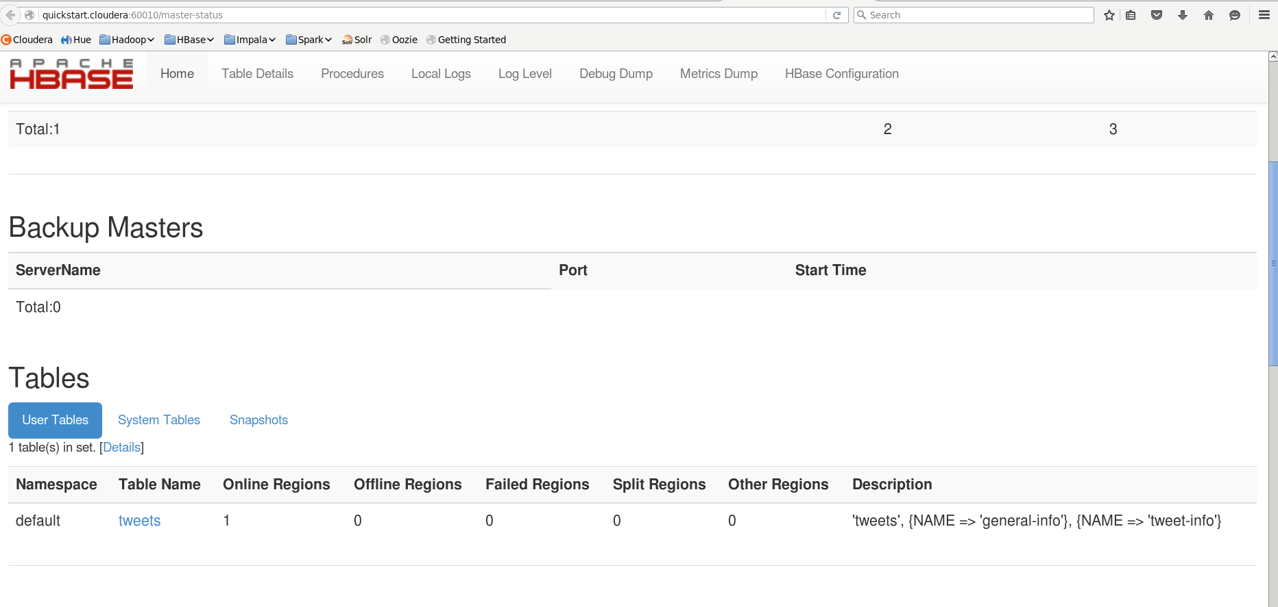
HBASE

